Slide 1
RevPay – Secure Digital Banking System
Presented by: KARTHIK CHALAMALA

Slide 2
Problem Statement
Existing payment systems lack strong security and access control. No single platform supports both personal and business users effectively.
Transaction handling is often error-prone and poorly managed. Business users lack built-in invoice and loan management features. Need for a secure, scalable Java-based digital banking solution.

Slide 3

Issues with traditional payment systems
The project addresses significant issues in traditional payment systems, including:
Lack of security and scalability
Errors from manual transaction handling Limited financial features for businesses Need for a secure, role-based solution

Slide 4

Overview
RevPay is a secure digital banking solution designed for personal and business users. It facilitates money transfers, wallet management, and invoices, all powered by a robust Java and ORACLE SQL backend, ensuring reliability and efficiency.

Slide 5

Technologies
RevPay is powered by a robust technical stack that includes:
Java (Core Java, JDBC)
Oracle SQL Database for data management
Log4j for efficient logging
DAO G Service Layer Architecture Console-based User Interface for user interaction

Slide 6
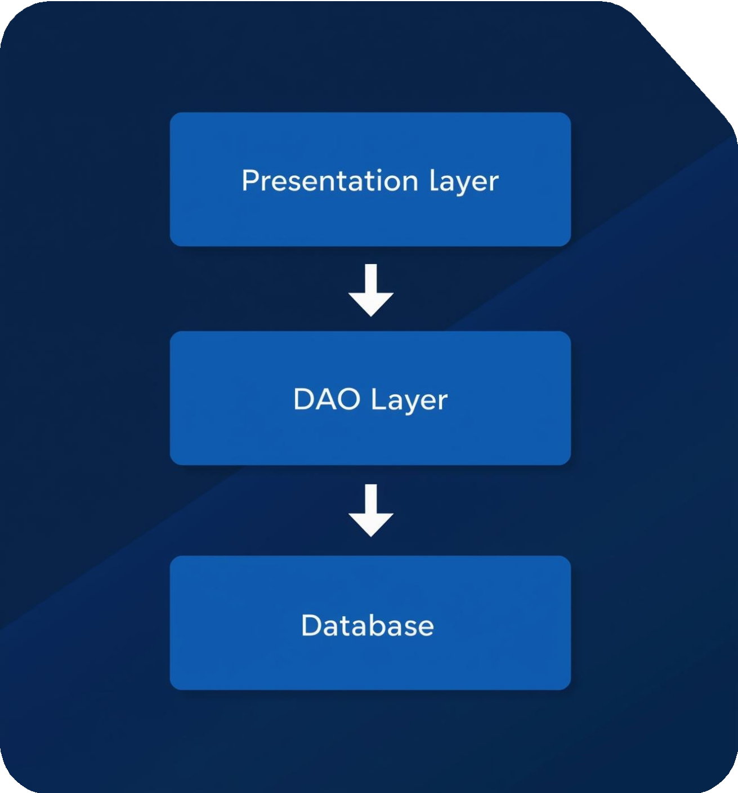
Architecture
RevPay utilizes a layered architecture for efficient processing and separation of concerns. Key components include:
Presentation Layer: Console UI Service Layer: Business logic DAO Layer: Database interaction Database Layer: Oracle Sql

Slide 7
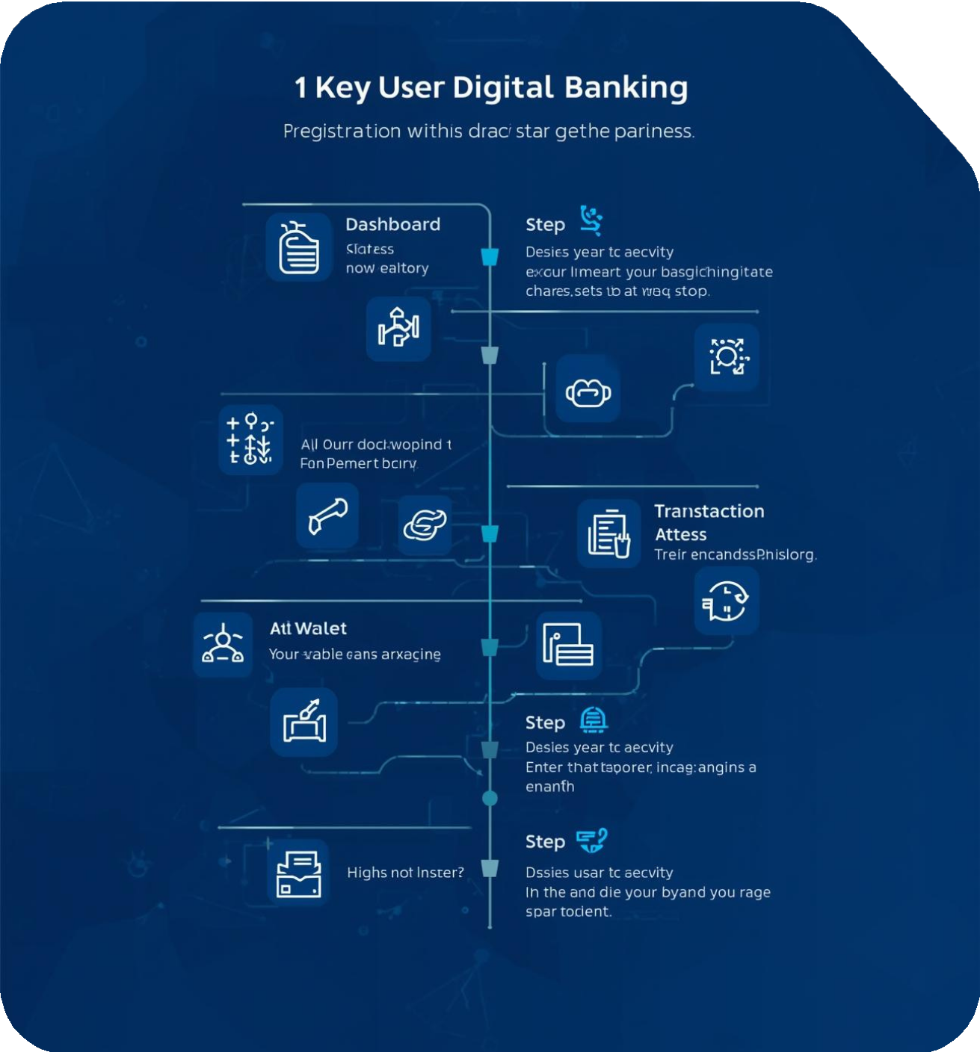
Workflow
The application workflow includes essential user activities such as:
User Registration G Login
Role-based Dashboard (Personal / Business) Wallet Operations: Add, Send, Request Money Business Operations: Invoices, Loans Transaction History G Logout

Slide 8
Security
RevPay incorporates essential security features to ensure safe transactions:
Password hashing for user authentication PIN-based verification for transactions Role-based access control mechanisms Secure database connectivity practices

Slide 9

Testing
The testing phase ensures application reliability and performance. Key methods include:
Unit testing with JUnit Database connection validation Functional transaction testing Manual user flow assessment

Slide 10

Logging
Implemented using Log4j 2 for flexible logging INFO logs track application flow efficiently ERROR logs capture runtime issues for analysis
FATAL logs report critical failures immediately Supports debugging and monitoring of system health

Slide 11

Challenges
Key development hurdles encountered during the creation of RevPay include:
Designing secure transaction flow Handling concurrent balance updates Database schema design complexities Error handling and input validation

Slide 12



Future Enhancements for RevPay System
Web UI
Expanding access via a responsive web platform
Spring Boot
Migrating to a more efficient framework
API Integration
Connecting to third-party services for functionality

Slide 13

Thank You for Your Attention
Email :
karthik1237t@gmail.com

